Slide 1
From Association to Modelling Causality
PSYC 234 Week 11
Dr. Emma Mills
e.mills@lancaster.ac.uk

Slide 2
Benefits of Regression:
Flexibility
Statistical Power
Predictions
Extensions

Slide 3
At what cost?
More variables – more complexity in understanding the model
Data preparation may be more indicated
The intercept term
Reference levels
Understanding how the variables work together or making predictions
  get ready to some maths

Slide 4
Weeks 11 - 15
Continuation of learning from PSYC 122
  Correlation, Simple regression, Multiple Regression
Deeper Dive into multiple regression methods
  Categorical and continuous variables
  Variables with more than three levels
  Strategies to help interpretation when the model summary looks strange
  Interactions in the linear regression model
Mediation models
Variable reduction using Factor Analysis methods

Slide 5
Weeks 15 – 19 with Dr Amy
Non-parametric methods
Logistic regression
Ordinal regression

Slide 6
Week 20
Class test – 100% of course assessment
  58 Multiple choice Qs
  12 Qs related to some coding in R with interpretation for answering questions
  1 hour 50 mins (longer for those with adapted assessment arrangements)
  Check 234 Moodle & your timetable for date, time and your venue.

Slide 7
Formative Assessment
Web Based Quizzes
  To help you both understand what you know and what you don’t yet know
  Each week’s quiz relates to lecture content
Supporting text:
  Howell, D. C. (2017). Fundamental statistics for the behavioral sciences (Ninth edition.). Cengage.
    Chapters 9, 10 and 11; working through those will consolidate the points in lectures and learning in labs – I can help with checking answers to questions (Just give me some notice that you would like that).

Slide 8
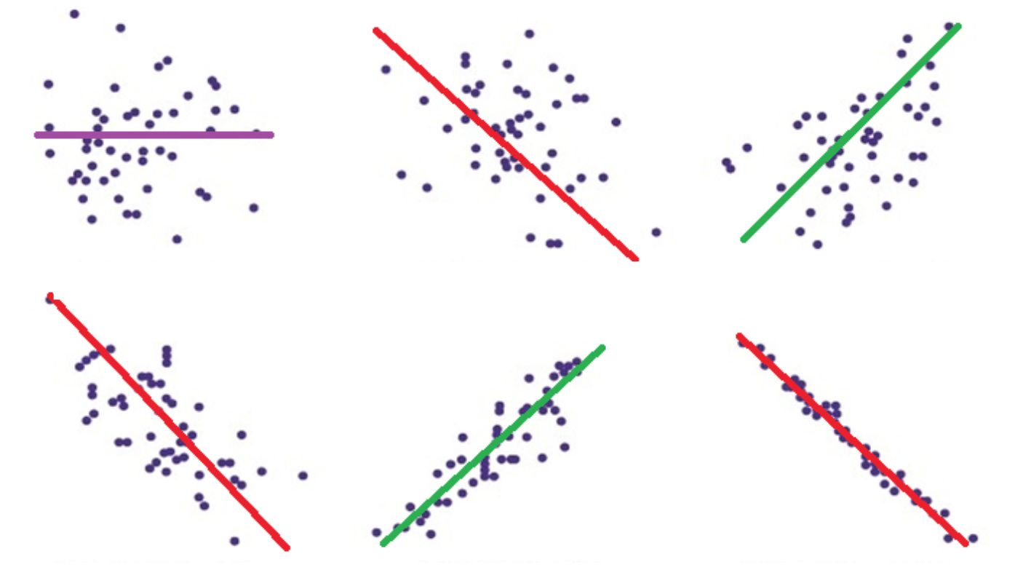
Review: Correlation: Pearson’s r
The strength and direction of the relationship between two continuous variables
Values between -1 and 1

Slide 9
Review: Correlation:
X₁
X₂
X₁
X₁
X₂
X₂

Slide 10

Review: Correlation: Pearson’s r:
Mathematical Formula
$$covariance= \frac{Σ\left(X_{1} − \overline{X_{1}}\right)∗\left(X_{2} − \overline{X_{2}}\right)}{N−1}$$
$$r= \frac{covariance}{SD\left(X_{1}\right)∗SD(X_{2})}$$

Slide 11
Review: Correlation: Pearson’s r: Assumptions
Interval scale variables
Full data
Variables are normally distributed (hint: qq-plots)
The relationship is linear
  Not curvilinear
Constant variance – or homoscedasticity

Slide 12
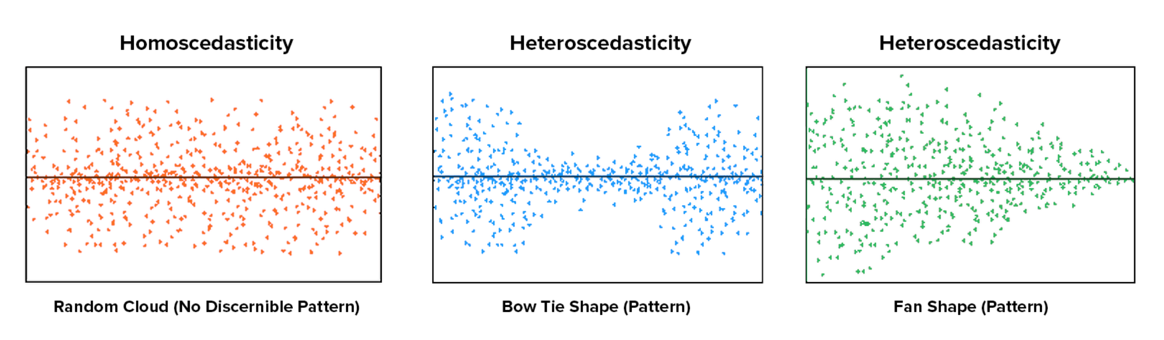
Review: Correlation: Pearson’s r: Assumptions
Homoscedasticity…

Slide 13
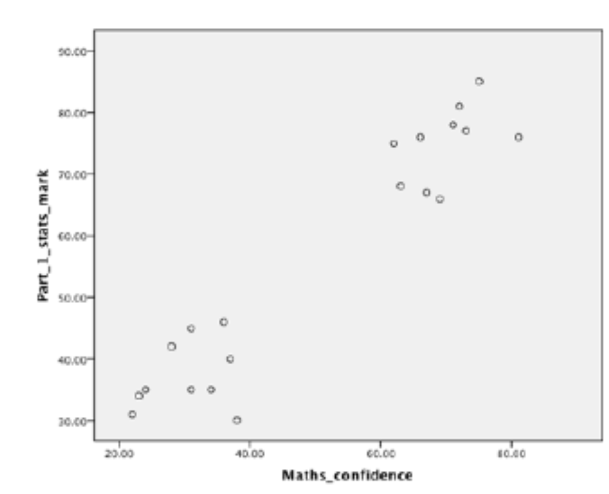
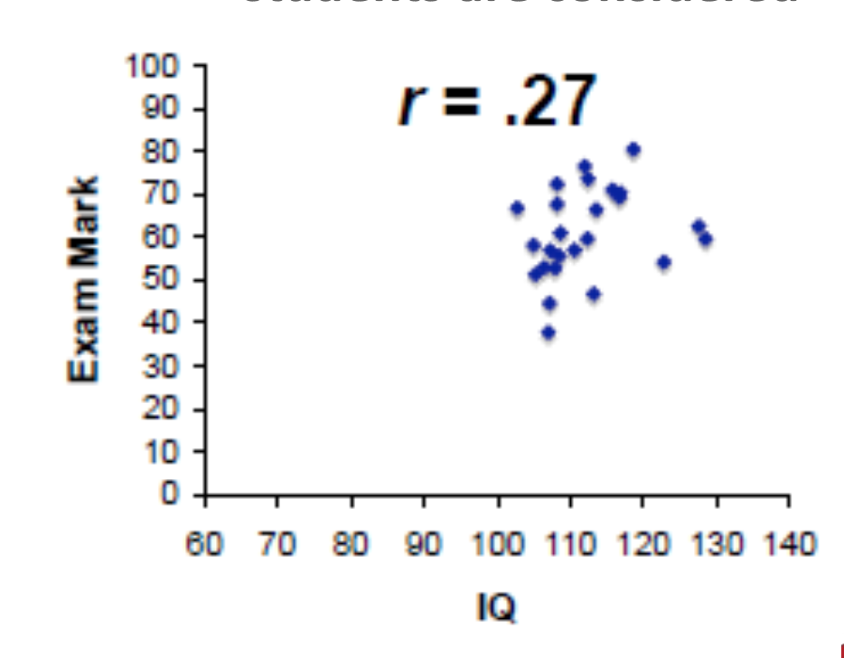
Review: Correlation: Pearson’s r:
Threats to Measurement Precision
Outlier datapoints
Range restriction:
  Using a sample that is not representative of the possible range of scores
Using a sample that actually seems to be two distinct groups

Slide 14
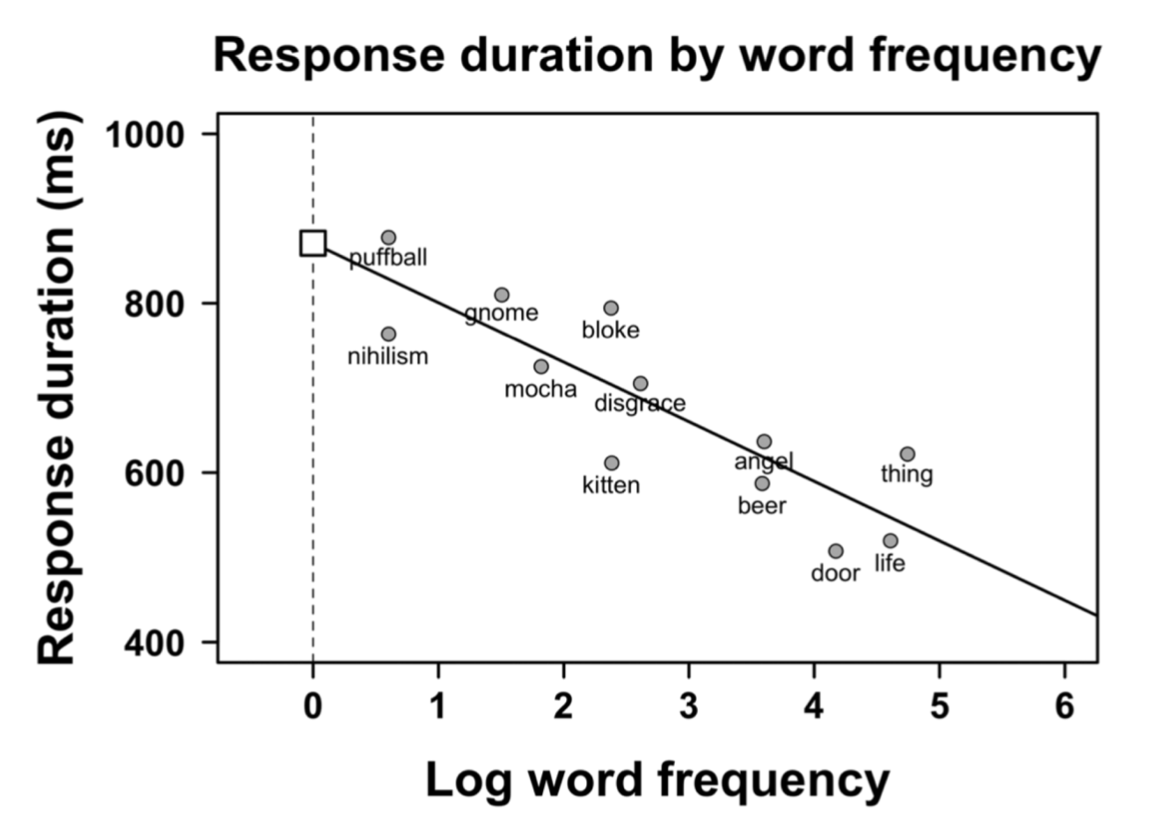
From Correlation to Simple Regression
(X, Y)
b = -70

Slide 15

From Correlation to Simple Regression
(X₁, X₂) -> (X, Y)
Line of best fit
  Intercept = b₀
  slope = b₁*x
$$b \text{= −70}$$

Slide 16
From Correlation to Simple Regression
(X₁, X₂) -> (X, Y)
Line of best fit
  Intercept = b₀
  slope = b₁*x
$$b \text{= −70}$$

Slide 17
Simple Regression: simple diagram
X₁
Y
X₁
X₁
Y
Y

Slide 18

Review: Simple Regression
Mathematical Formula for a Regression Line
$$y=b_{0}+ {(b}_{1}∗x_{1})+e$$
Outcome
variable
Intercept

Slide 19

Review: Simple Regression
Mathematical Formula for the Regression Line
$y=b_{0}+ {(b}_{1}∗x_{1})+e$
Slope term
Outcome
variable
Predictor
variable
Intercept
Beta
coefficient

Slide 20

Review: Simple Regression
Mathematical Formula for the Regression Line
$y=b_{0}+ b_{1}∗x_{1}+e$
Slope term
Outcome
variable
Predictor
variable
Intercept
Beta
coefficient

Slide 21
Review: Simple Regression
Mathematical Formula for the Regression Line
$y=b_{0}+ b_{1}∗x_{1}+e$
Slope term
Residual
Error
Outcome
variable
Predictor
variable
Intercept
Beta
coefficient

Slide 22
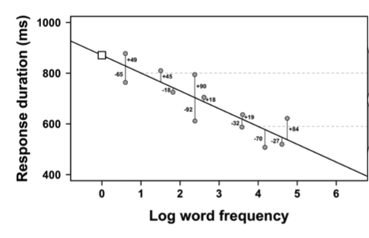

Residuals (in the error term)
$$b \text{= −70}$$

Slide 23

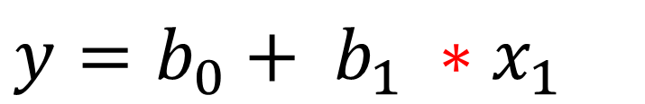
Predictions from Simple Regression
$$y=b_{0}+ b_{1} ∗x_{1}$$
$$b1 \text{= −70}$$

Slide 24
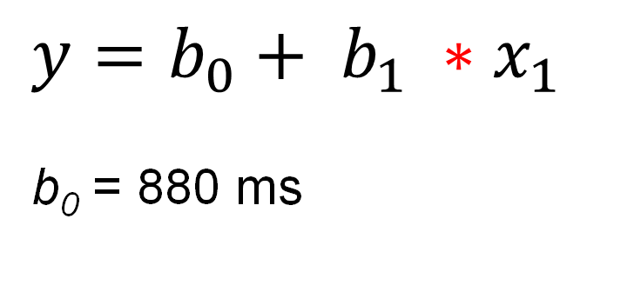
Predictions from Simple Regression
$$y=b_{0}+ b_{1} ∗x_{1}$$
b₀ = 880 ms
$$b \text{= −70}$$

Slide 25
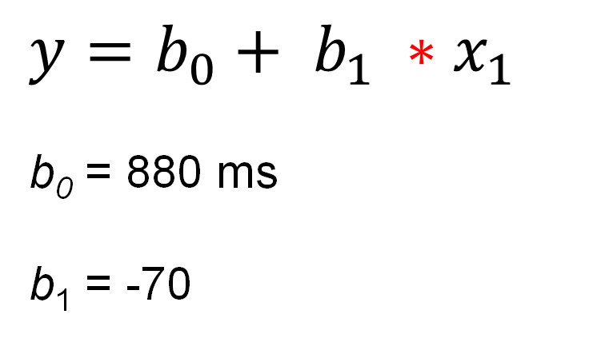
Predictions from Simple Regression
$$y=b_{0}+ b_{1} ∗x_{1}$$
b₀ = 880 ms
b₁ = -70
$$b \text{= −70}$$

Slide 26
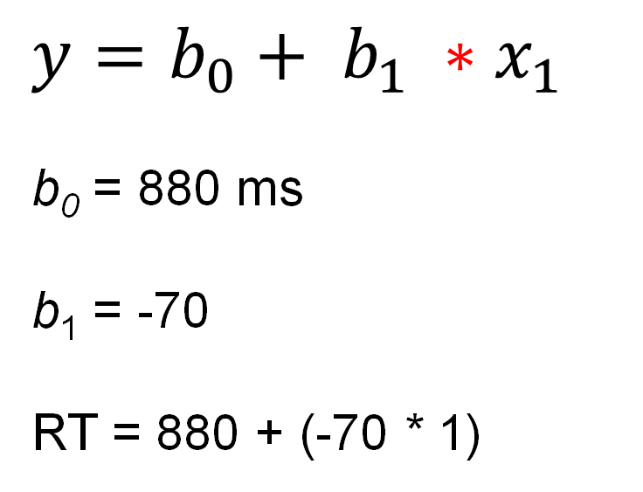
Predictions from Simple Regression
$$y=b_{0}+ b_{1} ∗x_{1}$$
b₀ = 880 ms
b₁ = -70
RT = 880 + (-70 * 1)
$$b \text{= −70}$$

Slide 27
Predictions from Simple Regression
$$y=b_{0}+ b_{1} ∗x_{1}$$
b₀ = 880 ms
b₁ = -70
RT = 880 + (-70 * 1)
$$b \text{= −70}$$
The response time for a word of log frequency 1 = 810 ms

Slide 28
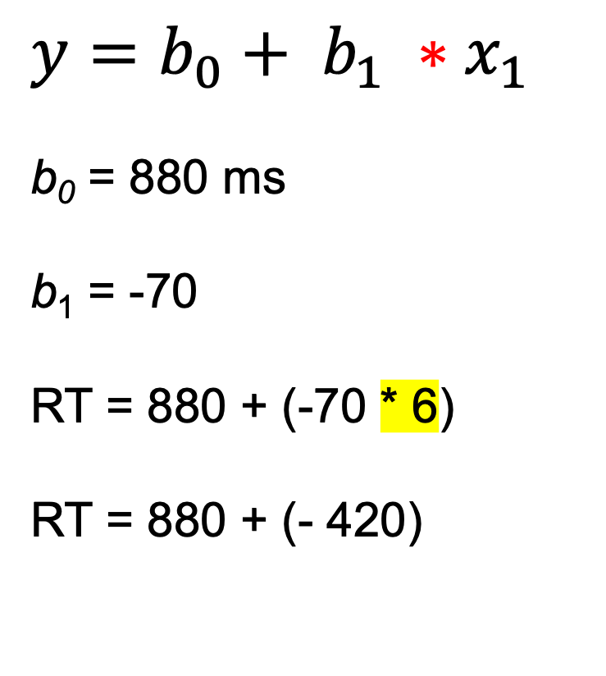
Predictions from Simple Regression
$$y=b_{0}+ b_{1} ∗x_{1}$$
b₀ = 880 ms
b₁ = -70
RT = 880 + (-70 * 6)
RT = 880 + (- 420)
$$b \text{= −70}$$
The response time for a word of log frequency 6 = 460 ms

Slide 29
Review: Simple Regression – Assumptions
Linearity for the relationship between Y and X
Independence of observations – you could scramble a dataset and the findings would not change
Homoscedasticity of residuals
Normally distributed residuals

Slide 30
Review: Simple Regression – Model Fit
Coefficient of Determination: R²
Null model
intercept and error term only
y = b₀ + e
Hypothesised model
intercept, predictor and error
y = b₀ + b₁*x₁ + e
$$R^{2}=1 − \frac{{SSE}_{model}}{{SSE}_{null}}$$

Slide 31
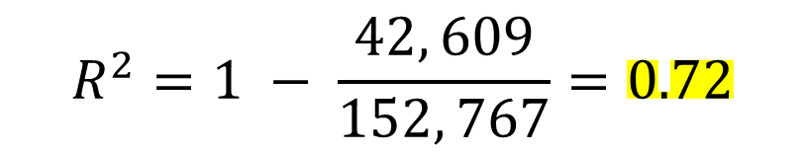
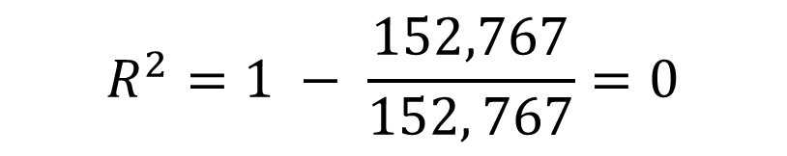
Review: Simple Regression – Model Fit
Null model
intercept and error term only
y = b₀ + e
SSE_{null} = 152, 767
Hypothesised model
intercept, predictor and error
y = b₀ + b₁*x₁ + e
SSE_{model} = 42, 609
$$R^{2}=1 − \frac{152,767}{152, 767}=0$$
$$R^{2}=1 − \frac{42, 609}{152, 767}=0.72$$

Slide 32
Simple Regression: Interpreting the output
Interpretation of Intercept term (b0)
  Average when all continuous predictors are at 0 or categorical predictors are at their reference level
Interpretation for continuous coefficients =
  A one unit increase in X gives a change in Y by the amount of b
Interpretation for categorical coefficients =
  A change to another level or group within X gives a change in Y by the amount of b

Slide 33
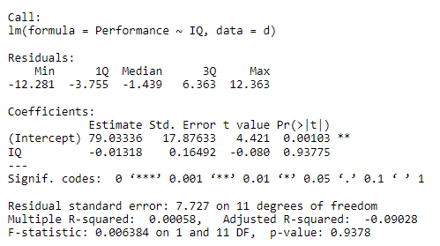
Simple Regression Model Summary in R

Slide 34
From Simple to Multiple Regression
There are more predictor variables
Some additional work in preparing the dataset for analysis
Still one intercept
  Some minor differences in interpretation for the intercept
Still one error term
Some additional detail for the interpretation and reporting of predictor variables

Slide 35
Simple Regression: simple diagram
X₁
Y

Slide 36
Simple Regression: simple diagram
X₂
X₁
Y
X₂
X₁
Y

Slide 37
From Simple to Multiple Regression
Several predictors
  Y = Intercept + predictor 1 + predictor 2 + Error
  Y = b₀ + b₁ * X₁ + b₂ * X₂ + e
Interpretation of Intercept term (b₀)
  Average when all continuous predictors are at 0 and categorical predictors are at their reference level
Interpretation for continuous coefficients =
  A one unit increase in X₁ gives a change in Y by the amount of b_{1,} when all other predictors are held constant / at their reference level
  A one unit increase in X₂ gives a change in Y by the amount of b_{2,} when all other predictors are held constant / at their reference level
  ...

Slide 38
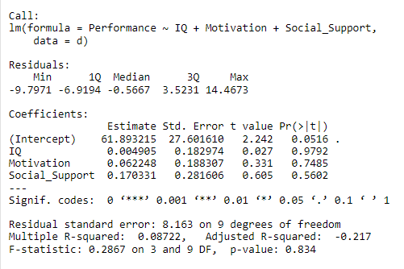
Multiple Regression Model Summary in R
Additional predictors

Slide 39
RStudio Demonstration

